Slide 1
G6T3
ESD Project Presentation
Notes:
Download more minimal templates here: https://crmrkt.com/GK9Dwa

Slide 2
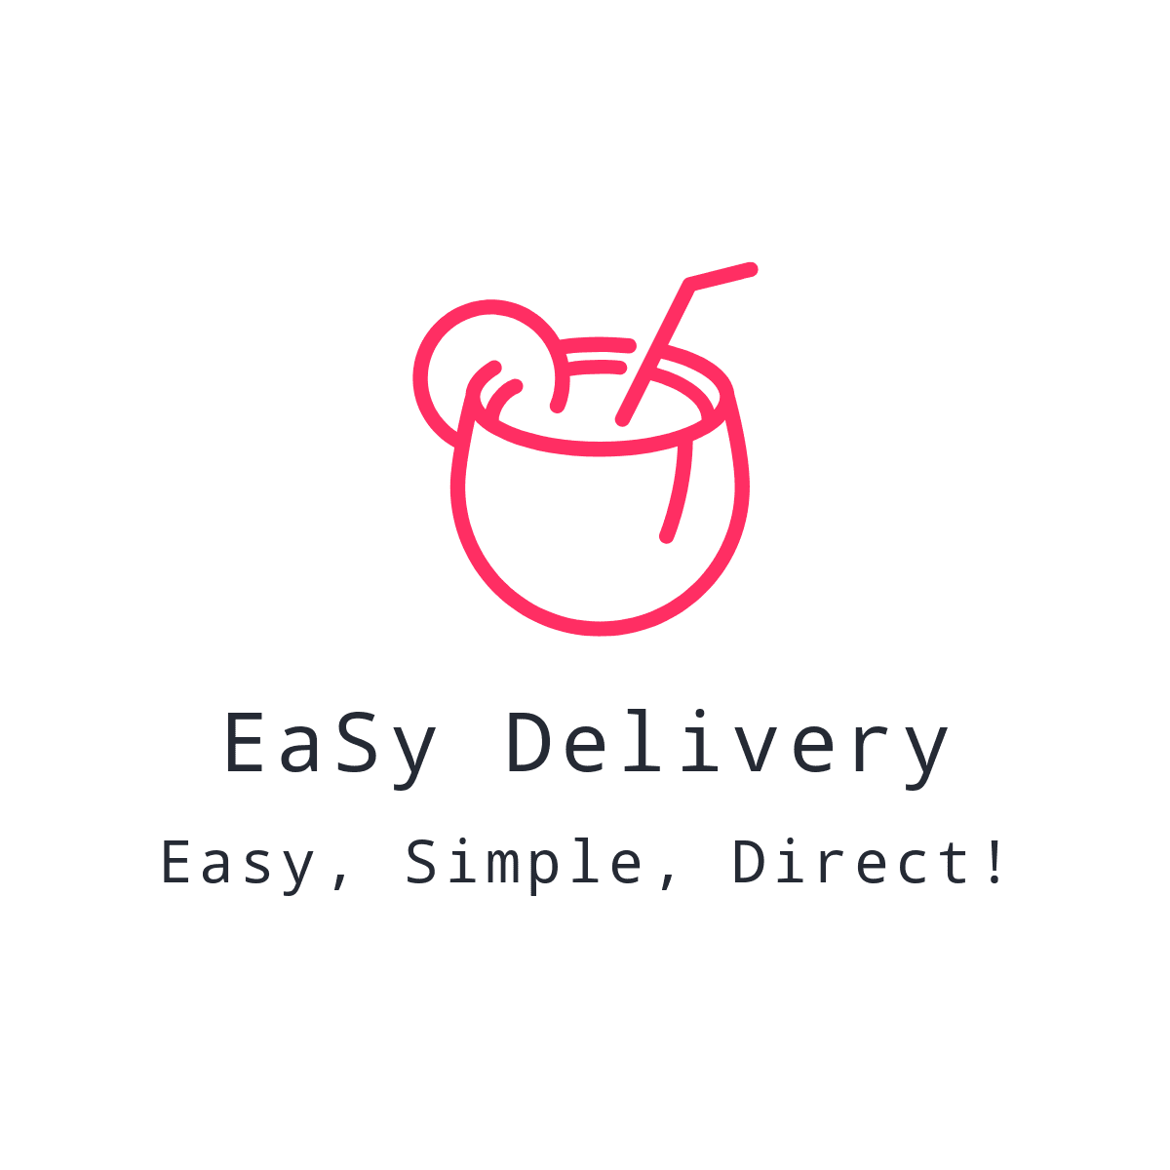
Members
Belle Lee
Chen Ziyi
Louis Low
Hao Jun Poon
Benjamin Wong
Masturah Binte Sulaiman
Notes:
Download more minimal templates here: https://crmrkt.com/GK9Dwa

Slide 3
What More We Do?
COMMUNICATION
RECOMMENDATION
CASHLESS
<Placeholder>
<Placeholder>
<Placeholder>
Notes:
Download more minimal templates here: https://crmrkt.com/GK9Dwa

Slide 4
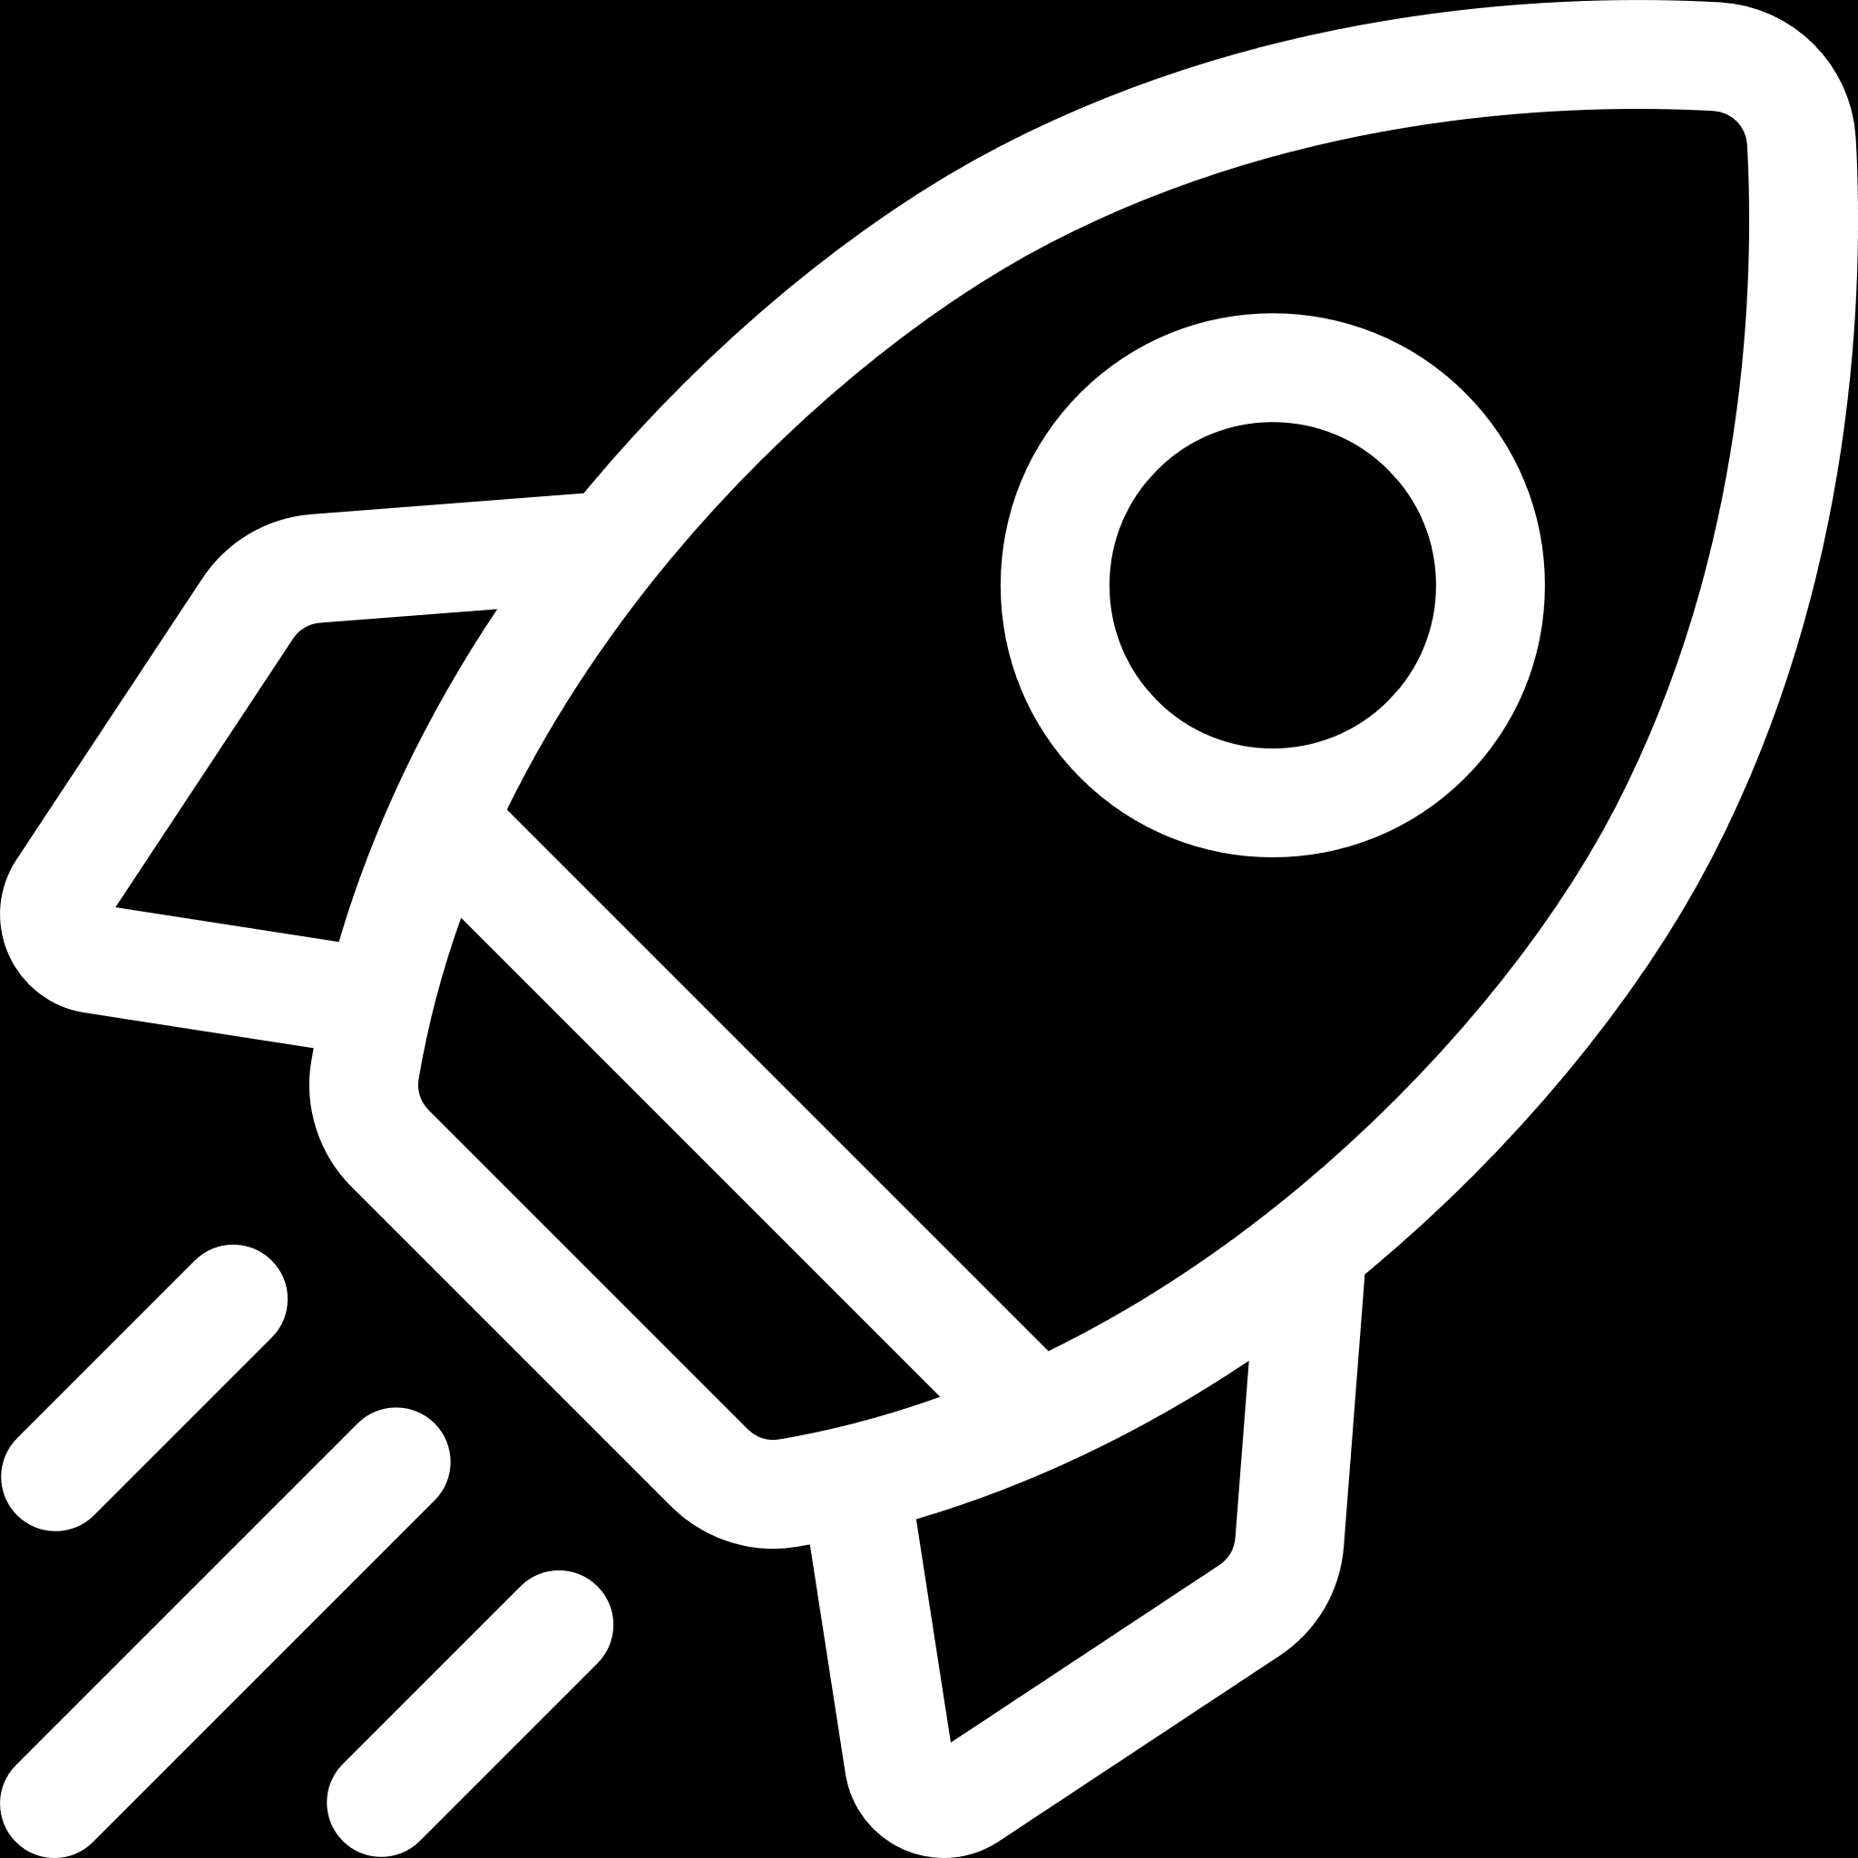
Above and Beyond
Beyond the Labs
Notes:
Download more minimal templates here: https://crmrkt.com/GK9Dwa

Slide 5


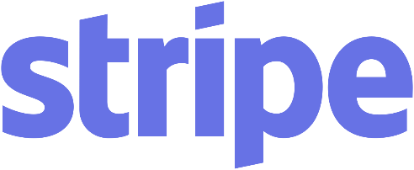


Open APIs
Payment
Authentication
Recommendation
Communication
Notes:
Download more minimal templates here: https://crmrkt.com/GK9Dwa

Slide 6




Deployment
Production Server
Docker!
Spring Boot Framework
Notes:
Download more minimal templates here: https://crmrkt.com/GK9Dwa

Slide 7


Scenario 1
Rest API
Menu
Service
Web
Storefront WebApp
Rest API
Recommend
Service
Rest API
Order
Service
Rest API
CRM
Service
Notes:
Download more minimal templates here: https://crmrkt.com/GK9Dwa

Slide 8
① Login
Rest API
Menu
Service
Web
Storefront WebApp
Rest API
Recommend
Service
Rest API
Order
Service
Rest API
CRM
Service
Notes:
Download more minimal templates here: https://crmrkt.com/GK9Dwa

Slide 9
② <>
Rest API
Menu
Service
Web
Storefront WebApp
Rest API
Recommend
Service
Rest API
Order
Service
Rest API
CRM
Service
Notes:
Download more minimal templates here: https://crmrkt.com/GK9Dwa

Slide 10
③ <>
Rest API
Menu
Service
Web
Storefront WebApp
Rest API
Recommend
Service
Rest API
Order
Service
Rest API
CRM
Service
Notes:
Download more minimal templates here: https://crmrkt.com/GK9Dwa

Slide 11
④ <>
Rest API
Menu
Service
Web
Storefront WebApp
Rest API
Recommend
Service
Rest API
Order
Service
Rest API
CRM
Service
Notes:
Download more minimal templates here: https://crmrkt.com/GK9Dwa

Slide 12
DOWNLOAD MORE
MINIMAL
PRESENTATIONS
DOWNLOAD
https://crmrkt.com/GK9Dwa
Notes:
Download more minimal templates here: https://crmrkt.com/GK9Dwa

Slide 13


Slides for Two Images
WORKS
WORKS
CREATIVE LAYOUTS
IMAGES PLACEHOLDERS
Frequently, your initial font choice is taken out of your awesome hands
Frequently, your initial font choice is taken out of your awesome hands
Notes:
Download more minimal templates here: https://crmrkt.com/GK9Dwa

Slide 14

Half Picture
Left Layout
ANALYSIS
Frequently, your initial font choice is taken out of your awesome hands also we are companies often specify a typeface, or even a set of fonts when selecting a typeface for body text, your primary concern should be readability don’t concern yourself.
FEATURE 01
FEATURE 02
Frequently, your initial font choice is taken out of your awesome hands
Frequently, your initial font choice is taken out of your awesome hands
Notes:
Download more minimal templates here: https://crmrkt.com/GK9Dwa

